Slide 1
COMPUTER NETWORKS
Assignment 1 part 1 ( video + pcap file)

Slide 2
01
INTRODUCTION
Assignment 1

Slide 3
UDP PROTOCOL
UDP is basically needed for the applications that mainly prioritize latency to reliability. That is, as soon as a UDP packet is sent there is no acknowledgement from the destination. Also, the loss of packets is not retransmitted, as a result, UDP is thus commonly used in applications where data can be contained in a single packet and where packet loss is not a major issue.

Slide 4
UDP protocol development
UDP
method used to transfer
large files across the internet
Why UDP to communictae ?
it does not require an acknowledgement to receive a file. Once the file has been requested from server it will be sent straight away
UDP speeds up transmissions by enabling the transfer of data before an agreement is provided by the receiving party

Slide 5
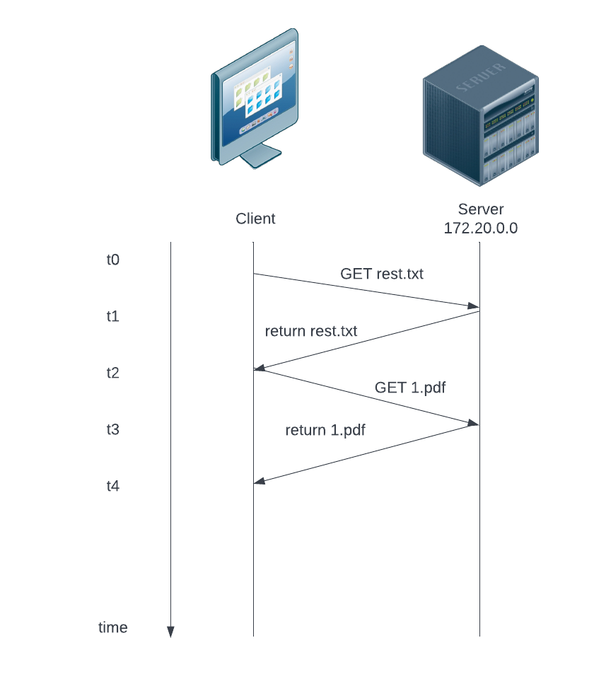
Initial design
I have developed a python script that utilizes UDP datagrams to send and retrieve files from the server to client
The design involves the following;
Server = ingress
Client

Slide 6
Explanation
Server starts listening to any incoming traffic. If the client sends a request, the server processes it and then forwards the reply to the client that had already established a connection.

Slide 7
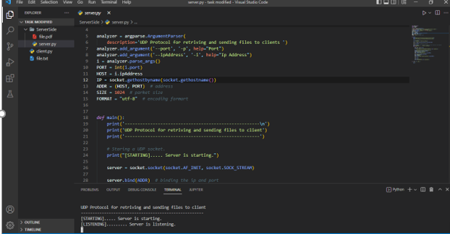
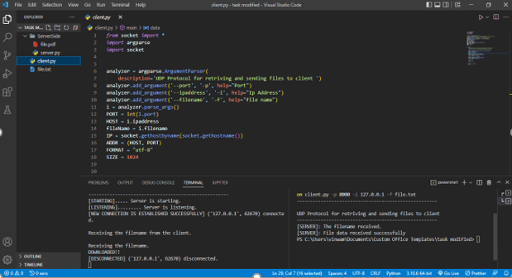
Python Scripts
☺

Slide 8
Topology
What I am using
Multiplexing
Encryption

Slide 9
ENCRYPTION
AES which is the advanced Encryption standard
I am using it cause :
Very secure
Fast
Can be implemented easily using a library in python called “ pycryptodome”

Slide 10
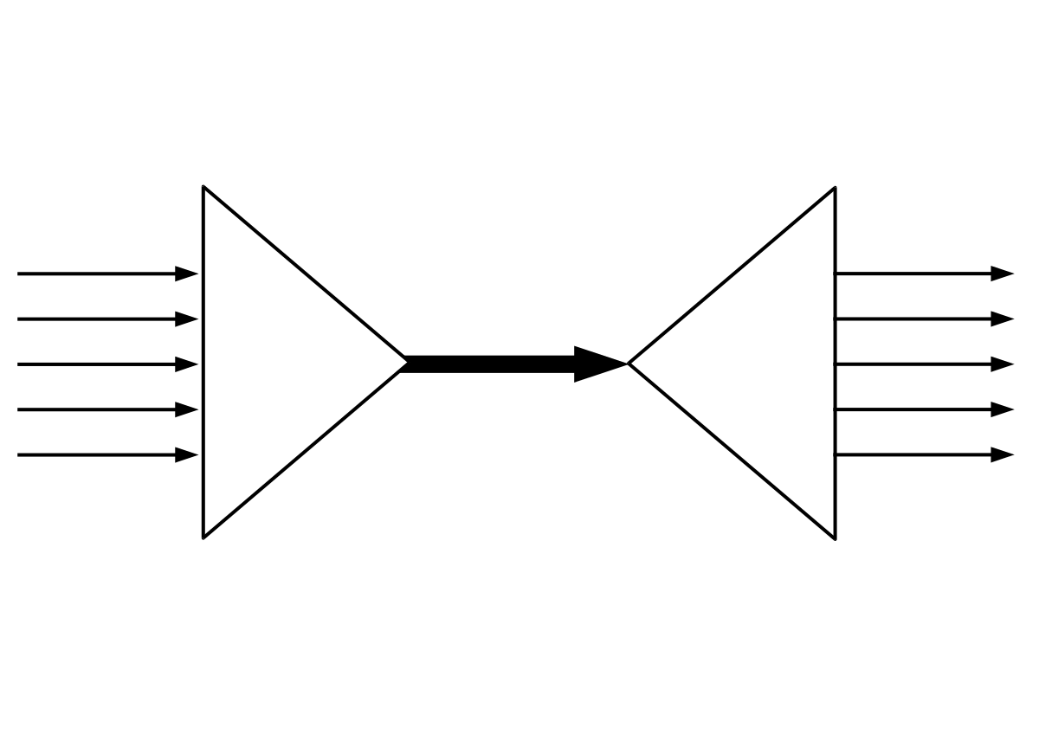
Multiplexing
is a way of sending multiple signals or streams of information over
a communications link at the same time in the form of a single, complex signal.

Slide 11
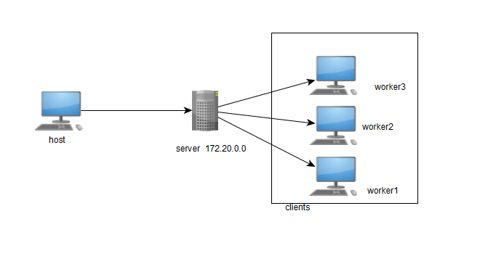
What I am trying to achieve
I have developed a python script that utilizes UDP datagrams to send and retrieve files from the server to clients(workers).
The design involves the following;
Host(sender)
Server = ingress
Clients = Workers

Slide 12
Explanation
When the host(sender) starts the server, it starts listening to any incoming traffic. If the host(sender) sends a request, the server processes it and then forwards the reply to the clients(workers) that had already established a connection.

Slide 13
Thanks for listening
Aziz

